Slide 1
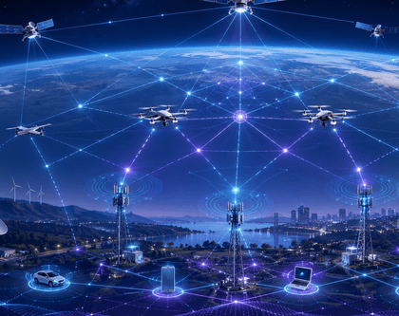
Team 3 - AI-Empowered Space-Air-Ground Integrated Networks (SAGIN)
Team Members:
Divyanshu Ratti
Henry Manjo
Rajdeep Kaur

Slide 2
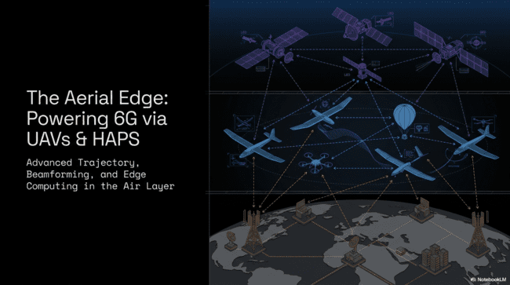

Slide 3
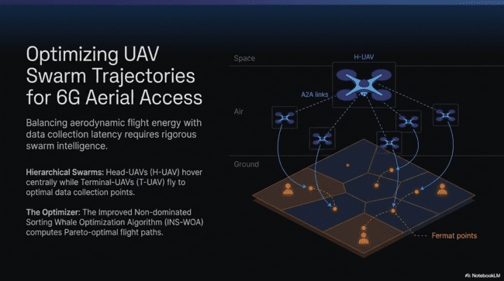

Slide 4
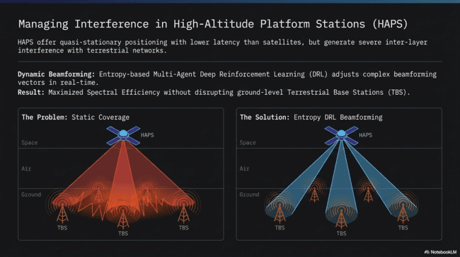

Slide 5
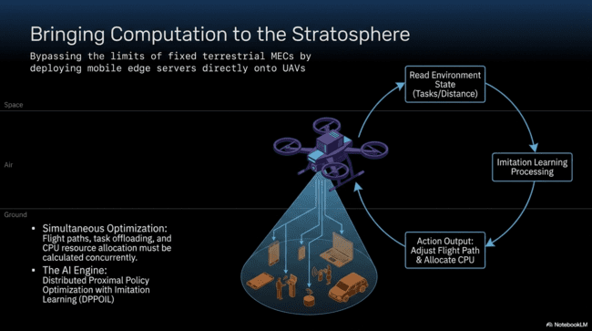

Slide 6
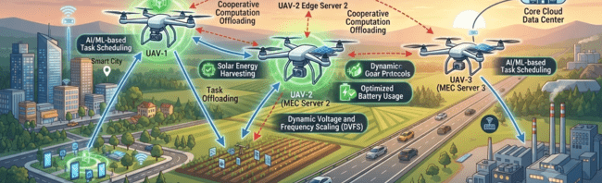
Joint Optimization in Multi-UAV MEC
Overcoming Siloed Approaches: Traditional methods treat UAV flight paths and compute resource allocation separately, leading to systemic inefficiencies. Zhang et al. (2025) solve both challenges jointly using Deep Reinforcement Learning (DRL).
Real-Time Adaptive Control: The intelligent model dynamically adapts UAV positioning and distributes computing resources to ground devices in real time, moving past rigid, fixed-rule allocations.
Measurable Performance Gains: Achieves significantly more users served, lower overall energy consumption, and reduced communication delay compared to standard legacy optimization baselines.

Slide 7
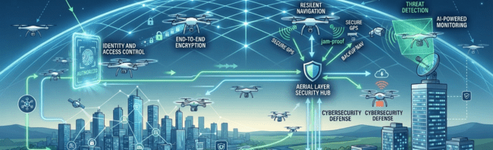
Securing the Aerial Layer
Edge AI for Physical Layer Security in 6G Non-Terrestrial Networks
Expanding Threat Landscape: As SAGIN connects satellites, drones, and HAPS, it becomes more exposed to interference, spoofing, jamming, and eavesdropping
Edge AI Defense: Chou et al. (2024) propose using Edge AI to detect threats and secure communications closer to where data is generated instead of relying on a distant central system.
Privacy & Speed: Techniques like federated learning and split deep learning keep processing local, improving both response speed and privacy

Slide 8
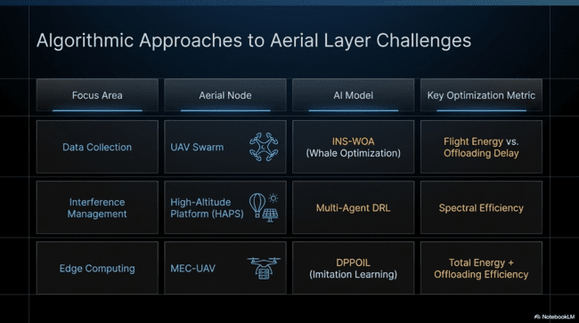

Slide 9
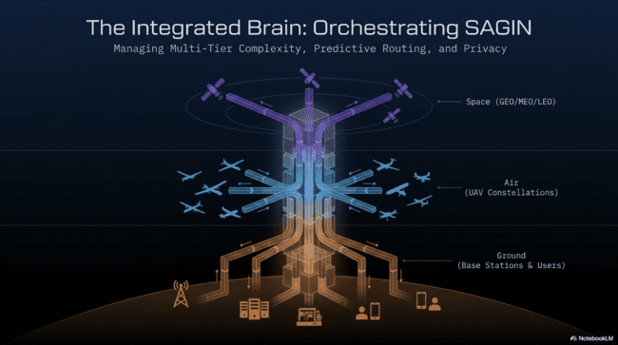

Slide 10
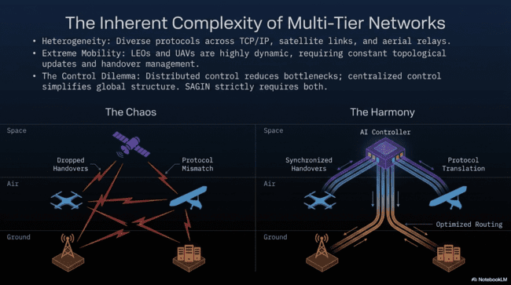

Slide 11
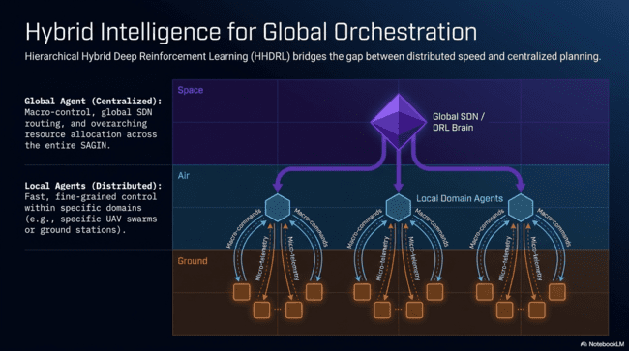

Slide 12
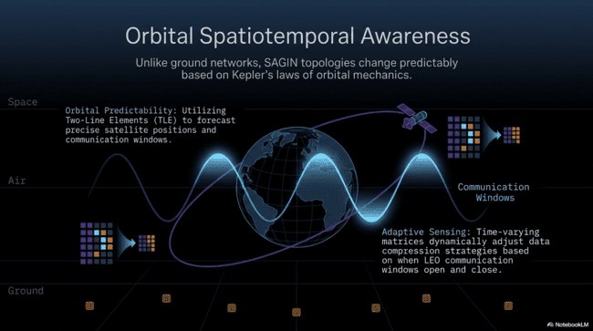

Slide 13
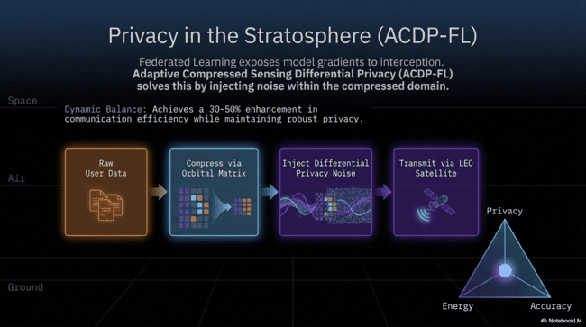

Slide 14
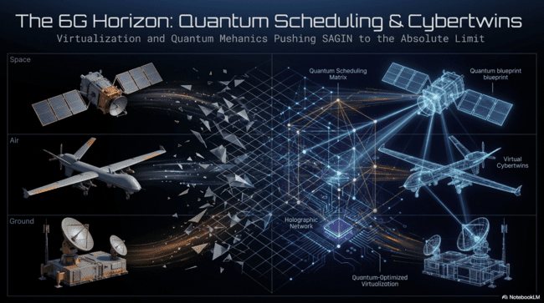

Slide 15
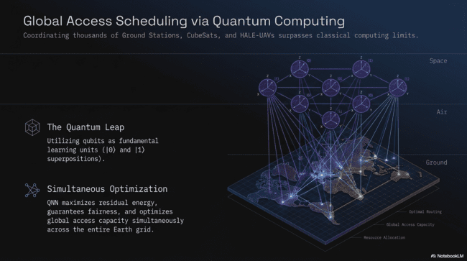

Slide 16
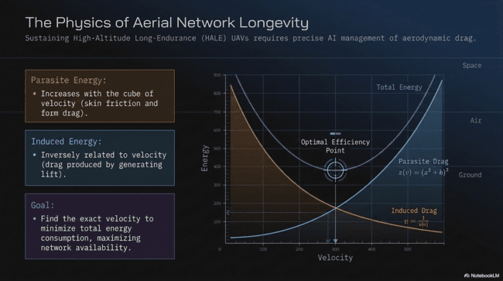

Slide 17
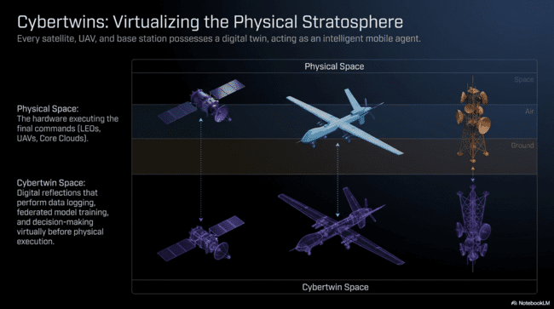

Slide 18
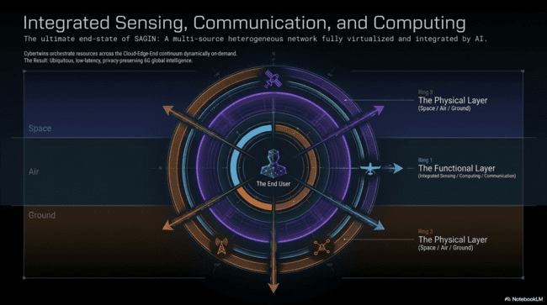

Slide 19
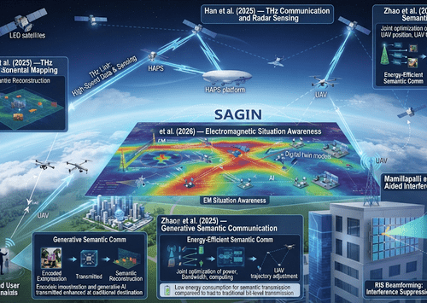
My Paper Summaries: Intelligent Communication & Resource Management
1. An et al. (2026) – Electromagnetic Situation Awareness
Uses AI, semantic analysis, and digital twins.
Models spectrum conditions and interference.
Improves awareness of the wireless environment.
2. Han et al. (2025) – THz Communication & Radar Sensing
Uses Terahertz frequencies for ultra-fast communication.
Enables both data transmission and environmental sensing.
Challenges include path loss, mobility, and hardware limitations.
3. Huang et al. (2024) – Generative Semantic Communication
Applies deep reinforcement learning.
Optimizes semantic image transmission.
Supports communication between satellites, UAVs, and ground users.
4. Zhao et al. (2025) – Energy-Efficient Semantic Communication
Uses semantic compression to reduce data transmission.
Optimizes UAV position, bandwidth, computing, and transmission power.
Improves energy efficiency.
5. Mamillapalli et al. (2026) – RIS-Aided Interference Suppression
Uses deep reinforcement learning for RIS beamforming.
Reduces interference between different network layers.
Improves spectrum efficiency and communication quality.

Slide 20
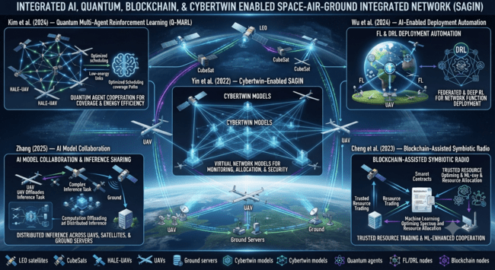

Slide 21
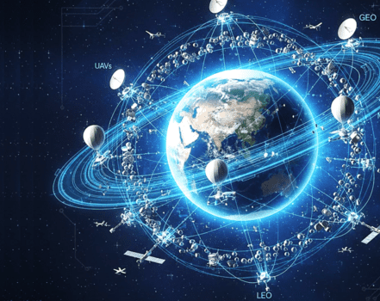
Thanks for listening

